Slide 1


Finding Fake News
Shashini Peiris
2499976

Slide 2
Advisors and Supervisors
Advisors: Dr. Craig Ramsay
Supervisors: Dr. Brian Pluss, Dr. Dimitra Zografistou, Mr. Andrew Cobley

Slide 3
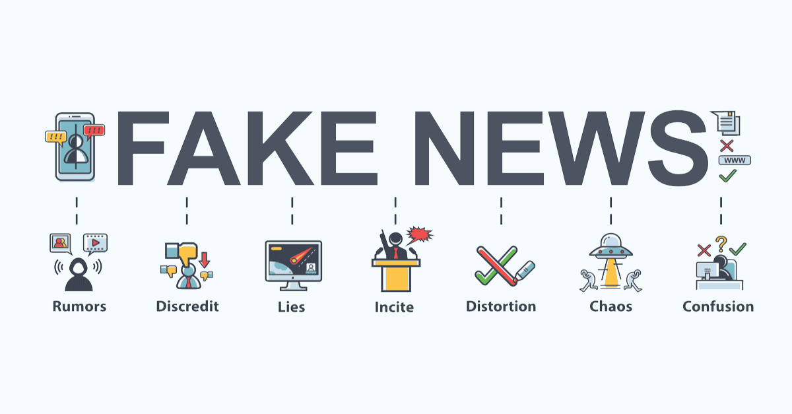

Slide 4
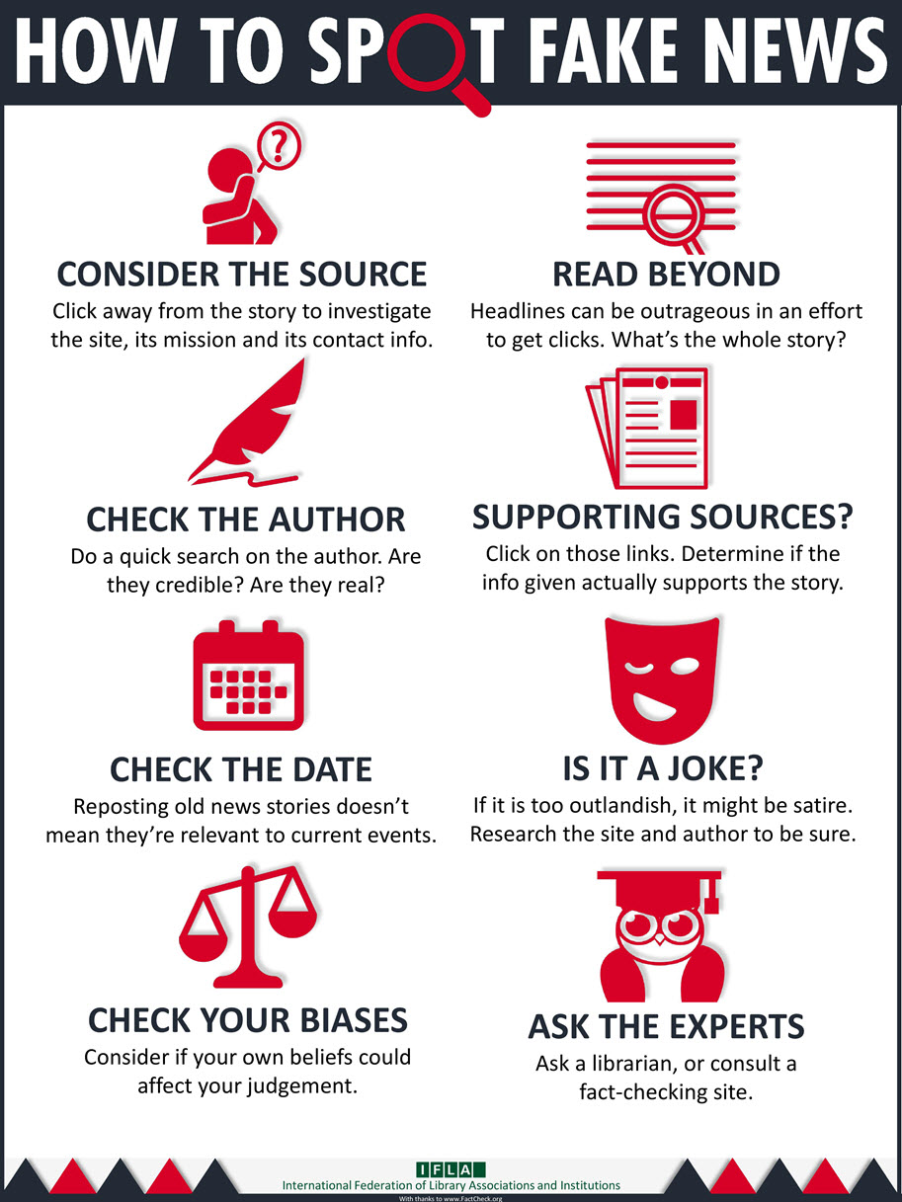
What is Fake News and How to identify?
Definition
The fake news term originally refers to false and often sensationalist information disseminated under the guise of relevant news.
How to detect fake news:
False information in it
Writing style of the article
Propagation pattern of articles
Credibility of its source

Slide 5

Approaches to identify Fake News
Language approach
Topic-agnostic approach
Machine learning approach
Knowledge-based approach
Hybrid approach

Slide 6
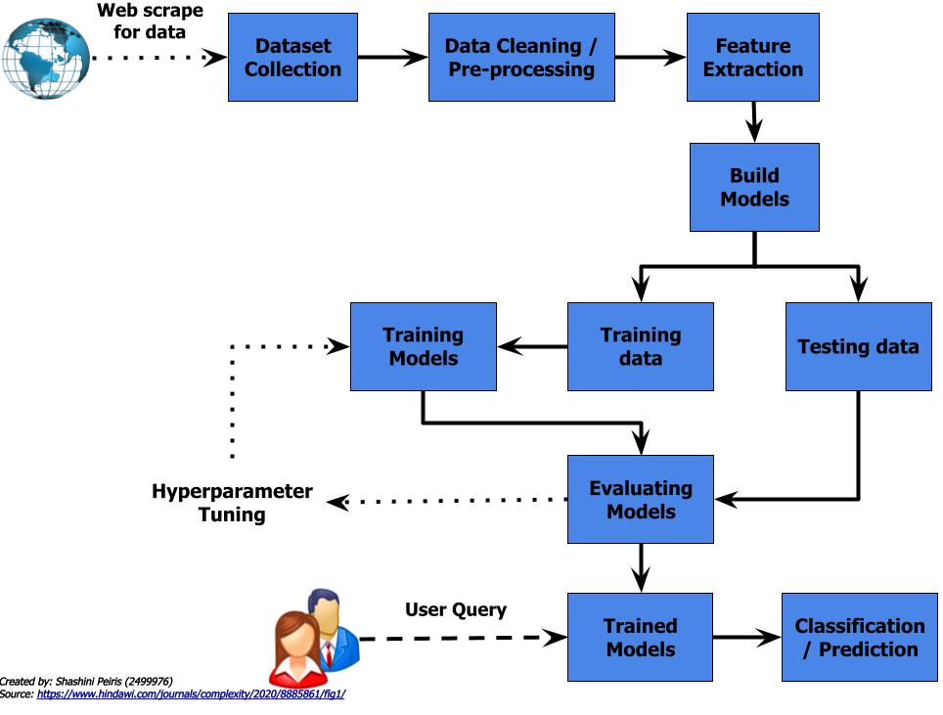
Process Flow

Slide 7
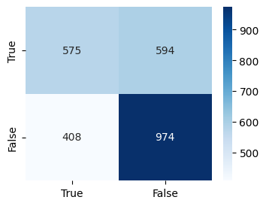
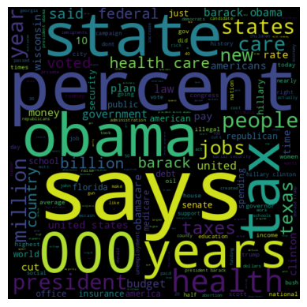
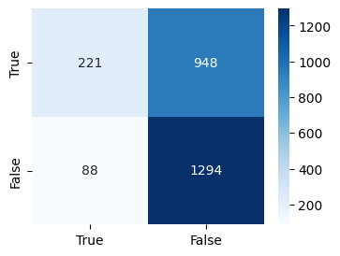
Techniques used
Feature Extraction
Tfidf Vectorizer
Count Vectorizer
Classifiers
Naïve Bayes
Logistic Regression
SVM
SGD
Random Forest
Passive Aggressive

Slide 8
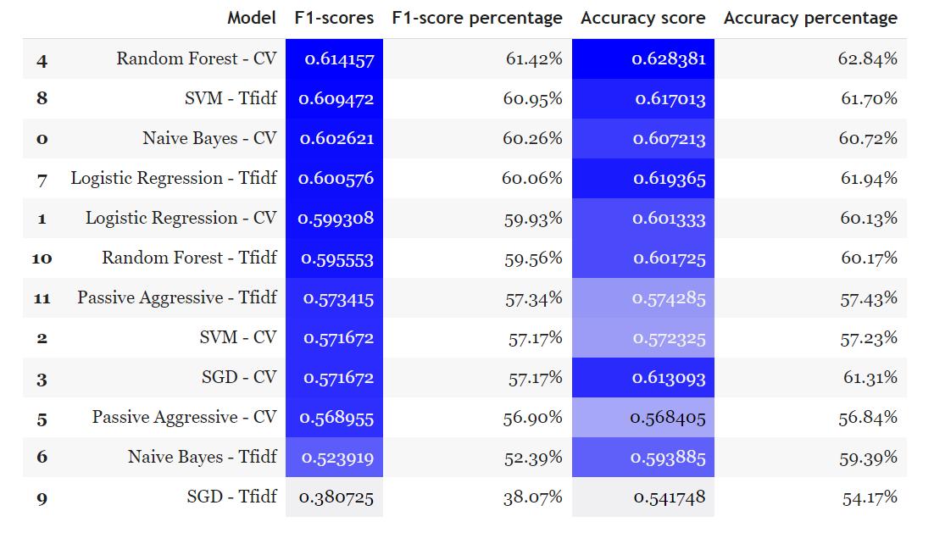
Evaluation - Tabular

Slide 9
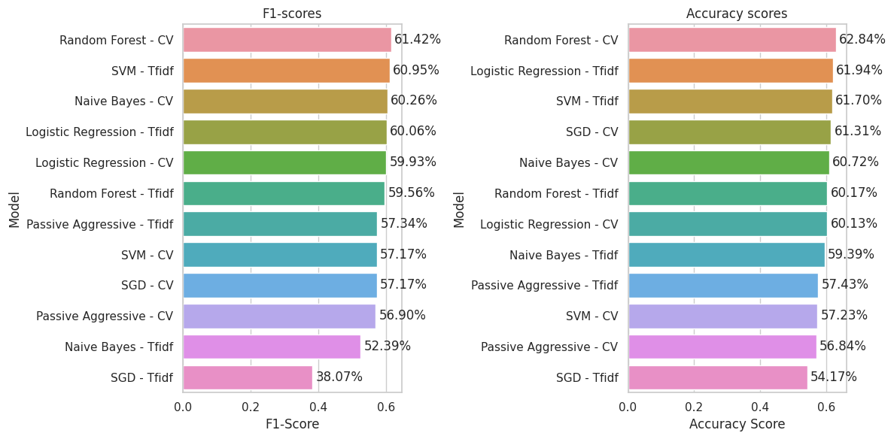
Evaluation - Horizontal Bar Charts

Slide 10
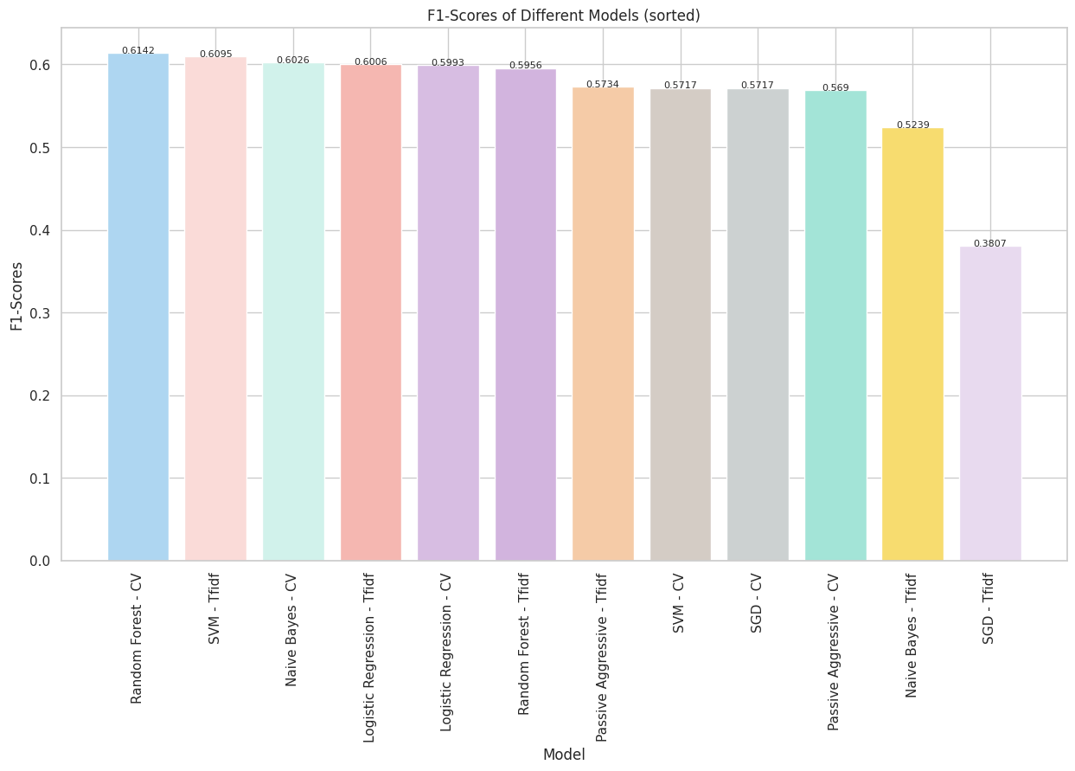
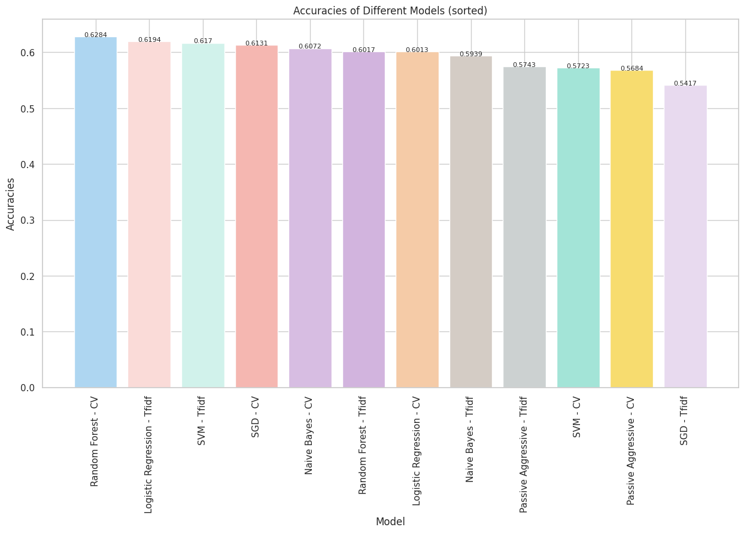
Evaluation - Bar Graphs

Slide 11
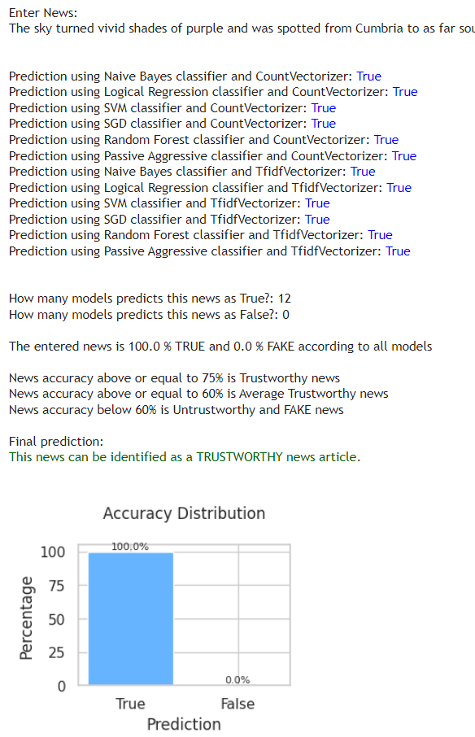
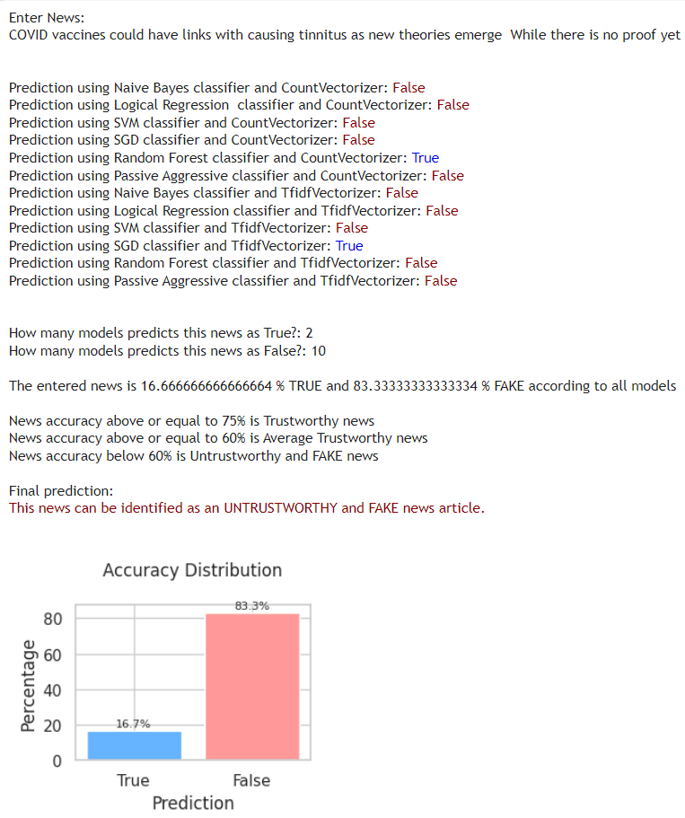
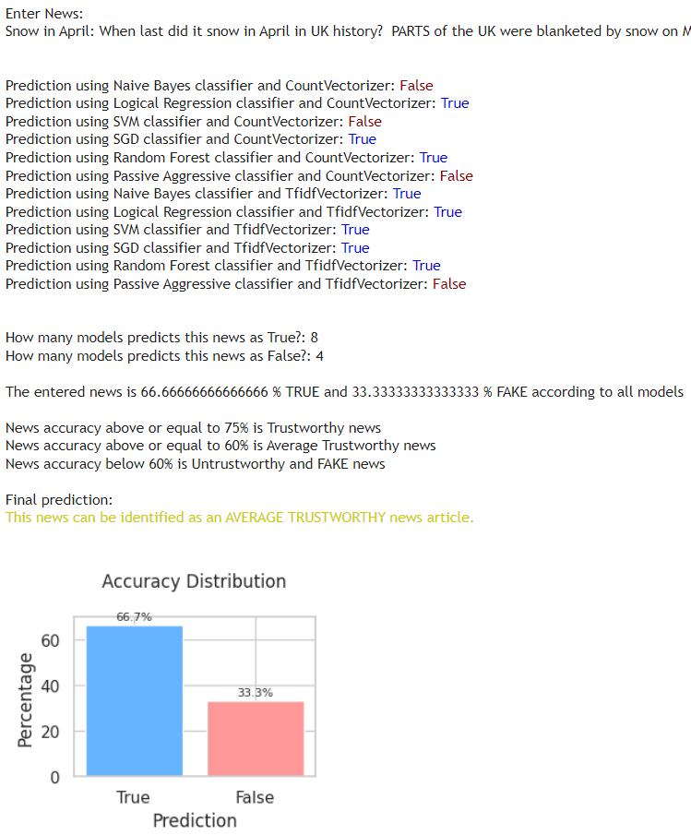
Predictions

Slide 12
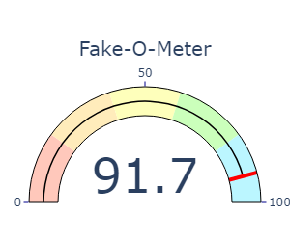
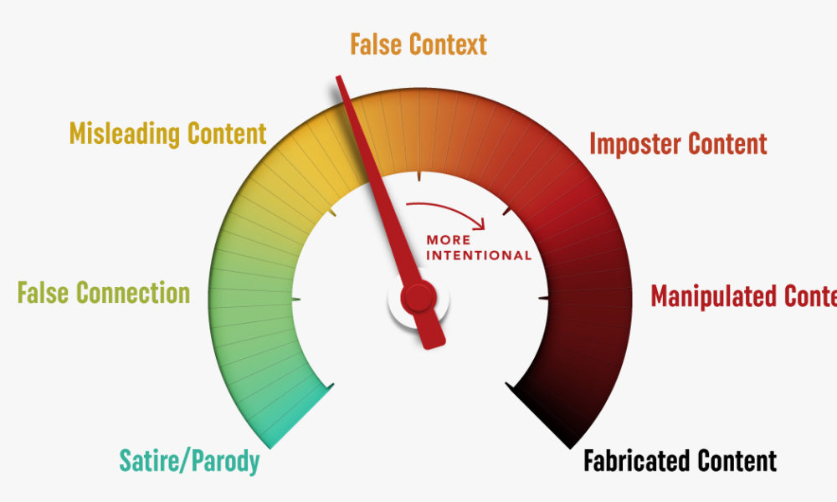
Final product

Slide 13


